Slide 1

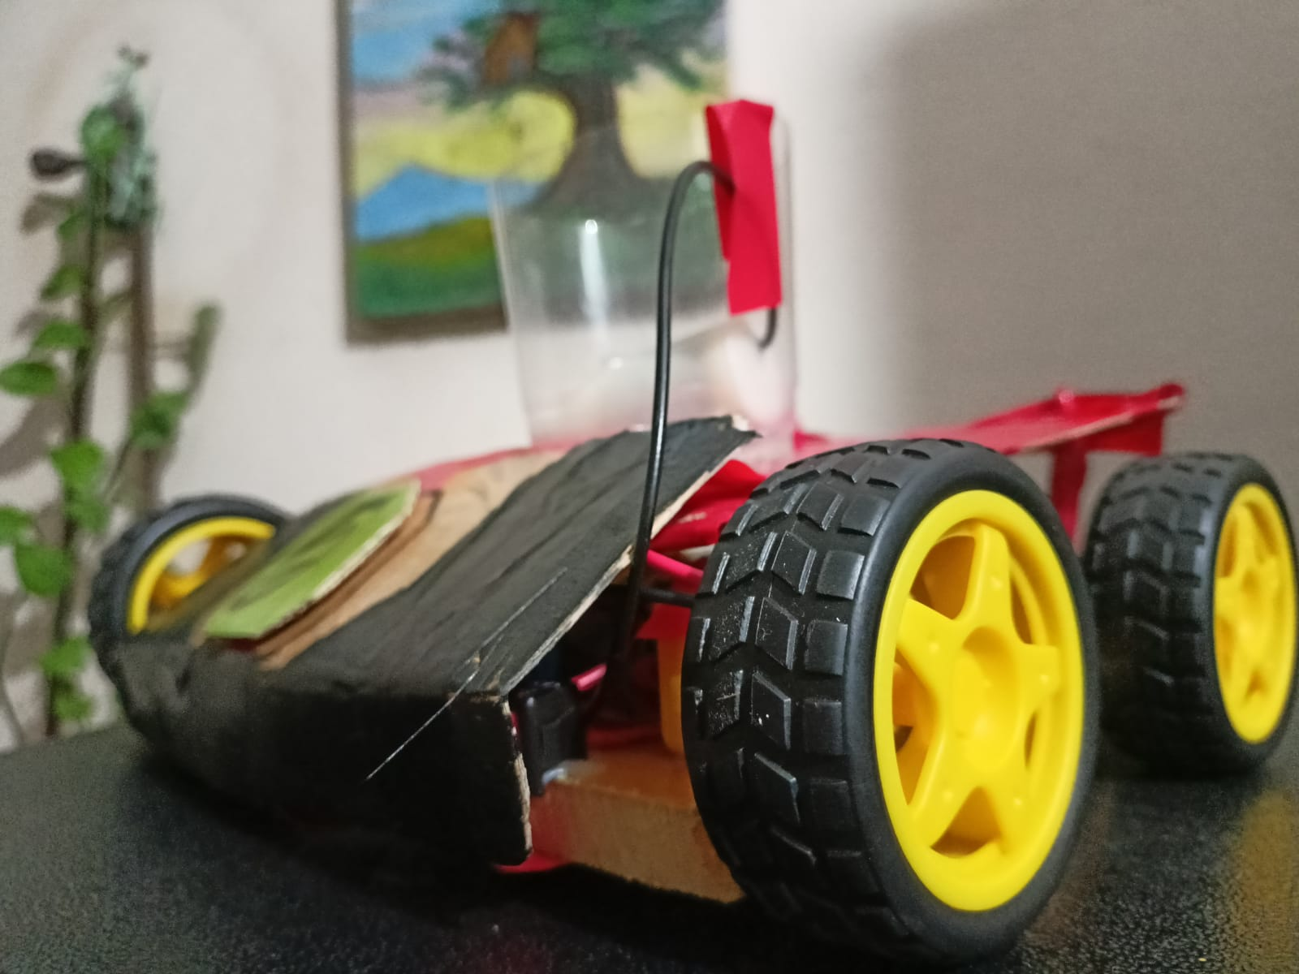
American International University- Bangladesh
MICROPROCESSOR AND EMBEDDED SYSTEMS
REMOTE-CONTROLLED PESTICIDE SPRAYING AND FIELD ASSISTANCE CAR FOR FARMERS USING ARDUINO
Supervised by:
Prof. Dr. Engr. Muhibul Haque Bhuyan
Professor
Department of Electrical and Electronic Engineering

Slide 2
Group 5
SL # | Students ID | Students Name | Program | Section
1 | 22-48990-3 | Shahriar Hossain | BSc in CSE | R
2 | 22-49002-3 | Al Mubtasim | BSc in CSE | R
3 | 22-49012-3 | Adiba Tanzila | BSc in CSE | R
4 | 22-49029-3 | MD.Rakib Hasan | BSc in CSE | R
5 | 22-49959-3 | Md.Imdadul Hasan(Ayon) | BSc in CSE | R

Slide 3

Title
Working Method
Aims and Objectives
Survey Report
Introduction
Results and Discussions
Literature Review
Limitations
How our work is Different
Future Scope
Apparatus
Conclusion

Slide 4
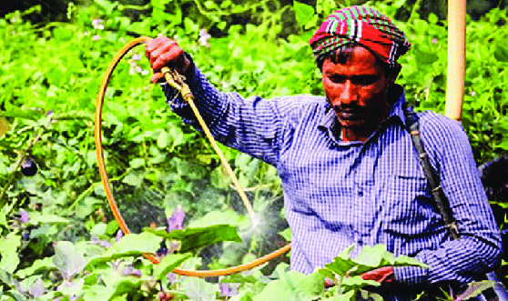
Introduction
Pesticides can cause neurotoxicity, carcinogenicity, and endocrine disruption—depending on the active compounds and exposure levels on humans [1].
• Manual methods are labor-intensive and inefficient for large fields
• IoT-based solutions like ESP32 offer smart, safe, and precise control
Notes:
Traditional pesticide spraying exposes farmers to harmful chemicals and relies on manual methods that are labor-intensive and inefficient for large fields. IoT-based solutions, such as those using the ESP32 microcontroller, provide smart, safe, and precise control, improving both safety and efficiency in pesticide application.​

Slide 5
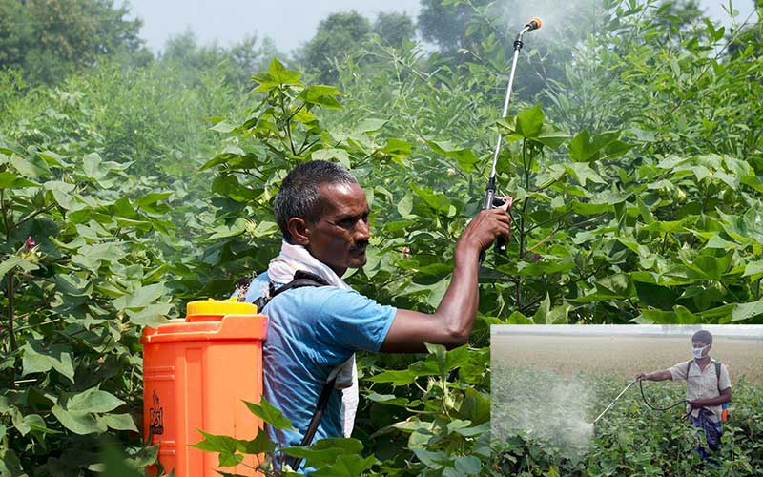
Introduction
•Ensure user safety by reducing direct contact with pesticides
•Promote automation in agriculture using low-cost microcontrollers
•Develop a scalable prototype for smart farming applications
Notes:
This project aims to enhance user safety by minimizing direct contact with pesticides through remote operation. It promotes automation in agriculture by utilizing low-cost microcontrollers, making advanced technology accessible to more farmers. Additionally, the development of a scalable prototype supports smart farming applications, paving the way for efficient and sustainable agricultural practices.​

Slide 6
Aims and Objectives of the Work
•To develop and incorporate Bluetooth or communication between a mobile device and the microcontroller to receive directional and spray commands remotely.
•To simulate and test motor control and spraying functions using Arduino IDE and Proteus to ensure accurate system responses before deploying the physical model.
•To implement control of dual motors via the L298N driver module for directional navigation and activate the pesticide pump through a relay-controlled sprayer.
Notes:
The project aims to develop a remote-controlled pesticide spraying vehicle by incorporating Bluetooth communication between a mobile device and the ESP32 microcontroller to receive directional and spray commands. It includes simulating and testing motor control and spraying functions using Arduino IDE and Proteus to ensure system accuracy before building the physical model. The design implements dual motor control via an L298N driver module for navigation and activates the pesticide pump through a relay-controlled sprayer. Finally, the system’s movement and spraying performance will be analyzed and validated in a test environment to ensure consistent operation and user safety.​

Slide 7
Aims and Objectives of the Work
•To design and implement a remote-controlled pesticide spraying vehicle using Arduino ESP32 microcontroller integrated with an L298N motor driver to automate safe pesticide application.
•To analyze and validate movement control and spraying mechanism performance in a test environment to ensure consistent operation and user safety.

Slide 8
Literature
Review
A research in 2023 introduced an IoT-based pesticide spraying robot that allows real-time user control.
However, it lacks sensors to detect terrain or obstacles, making it less effective in uneven or complex fields.
Another report in 2021 shows that they developed a solar-powered robot that can both spray pesticides and mow weeds.
The combination of multiple features makes the system too complex and expensive for small farms.
Notes:
N. Babu et al. (2023) introduced an IoT-based pesticide spraying robot enabling real-time user control. However, the lack of terrain or obstacle detection sensors limits its effectiveness in uneven or complex fields.​ ​ S. T. Ayyagari et al. (2021) developed a solar-powered robot capable of spraying pesticides and mowing weeds. However, the integration of multiple functions increases system complexity and cost, making it less suitable for small farms.​
​

Slide 9
Literature
Review
One of the latest research in 2025 presented a telerobotic sprayer for greenhouses using ultrasonic sensors to target plants.
While efficient in reducing pesticide use, the design is complicated and costly due to its reliance on real-time video and multiple sensors.
Some researchers in 2023 had designed a solar-powered pesticide sprayer using Bluetooth control.
The system depends heavily on sunlight and has a short operation time per tank, which limits its practicality in large fields or cloudy weather.
Notes:
M. A. Naik et al. (2025) presented a telerobotic sprayer for greenhouses using ultrasonic sensors for precise plant targeting. Although effective in reducing pesticide use, the system’s complexity and high cost stem from its dependence on real-time video and multiple sensors.​ ​ J. F. Kayode et al. (2023) designed a solar-powered pesticide sprayer controlled via Bluetooth. The system relies heavily on sunlight and has a limited operation time per tank, reducing its effectiveness in large fields or during cloudy weather.​

Slide 10
Literature
Review
Finally a research conducted in 202 proposed a remote-controlled sprayer with a self-propelled mechanism.
While the concept is promising, the paper lacks details on the control system and power source, making it hard to assess reliability or range.
Notes:
P. K. C. et al. (2024) proposed a remote-controlled sprayer featuring a self-propelled mechanism. Although the concept shows promise, the paper lacks sufficient details on the control system and power source, making it difficult to evaluate the device’s reliability and operational range.​

Slide 11
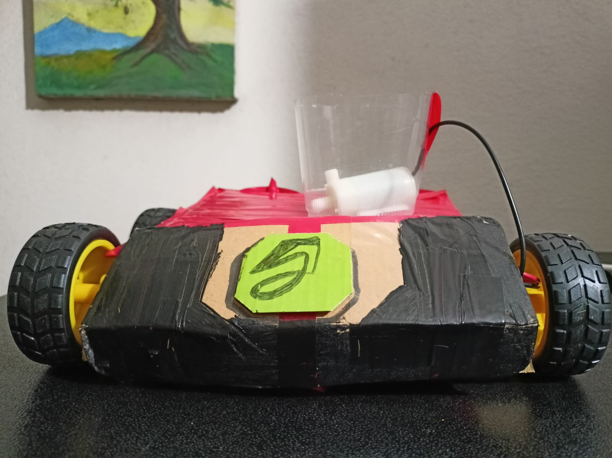
How Our Work Is Different
Simplified for Practical Use
▪ Focuses solely on spraying for easier construction, maintenance, and real-world use on small farms.
▪ Unlike Ayyagari et al., who combined mowing and spraying.
Affordable & Weather-Independent
▪ ESP32-based design operates without reliance on sunlight.
▪ More cost-effective and reliable than solar systems like Kayode et al.
Notes:
Our design focuses solely on pesticide spraying, simplifying construction and maintenance for practical use on small farms. This contrasts with Ayyagari et al.’s approach, which combined mowing and spraying, making their system more complex and less focused.​ ​ Our ESP32-based design operates independently of sunlight, making it reliable in all weather conditions. It is also more affordable and consistent compared to solar-powered systems like those developed by Kayode et al., ensuring greater usability for farmers regardless of environmental factors.​

Slide 12
How Our Work Is Different
Balanced Safety & Usability
Ensures safety via remote control.
Simpler than complex sensor/video setups used by Naik et al., making it farmer-friendly.
Notes:
Our system balances safety and usability by enabling remote control operation, protecting the user from direct exposure. Unlike the complex sensor and video-based setups used by Naik et al., our design is simpler and more farmer-friendly, making it easier to adopt and operate in the field.​

Slide 13
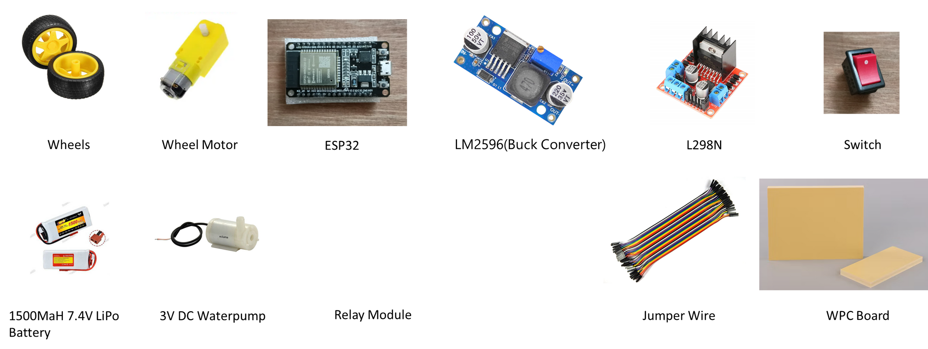
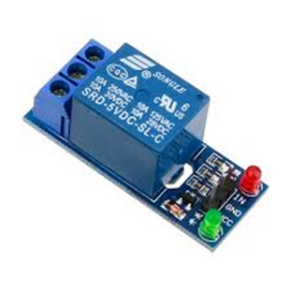
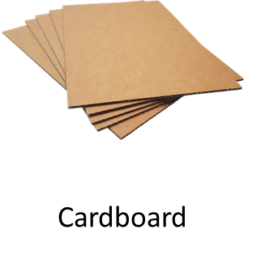
Apparatus

Slide 14
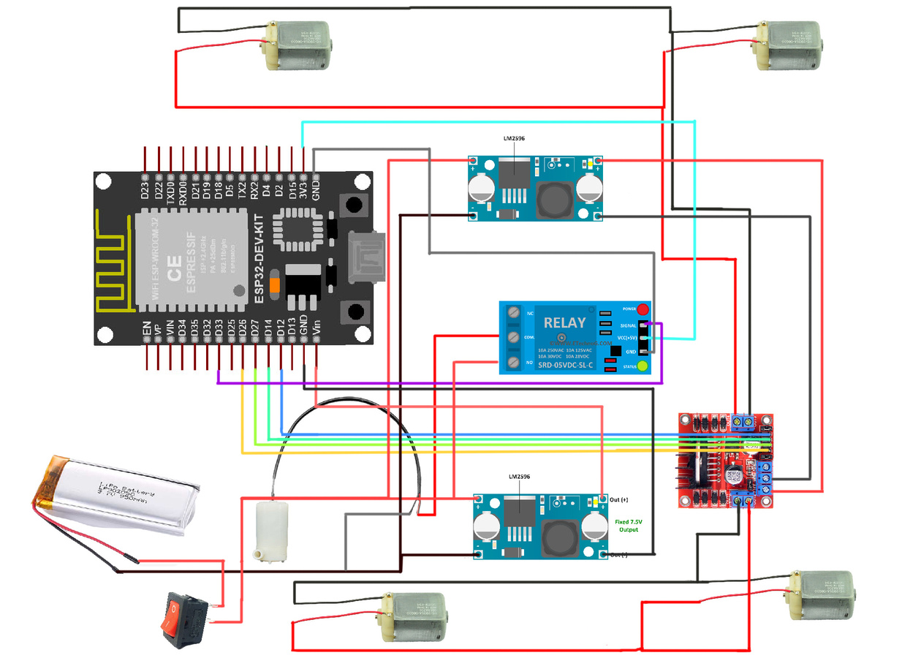
Schematic Diagram
Figure: Schematic Diagram of The Project

Slide 15
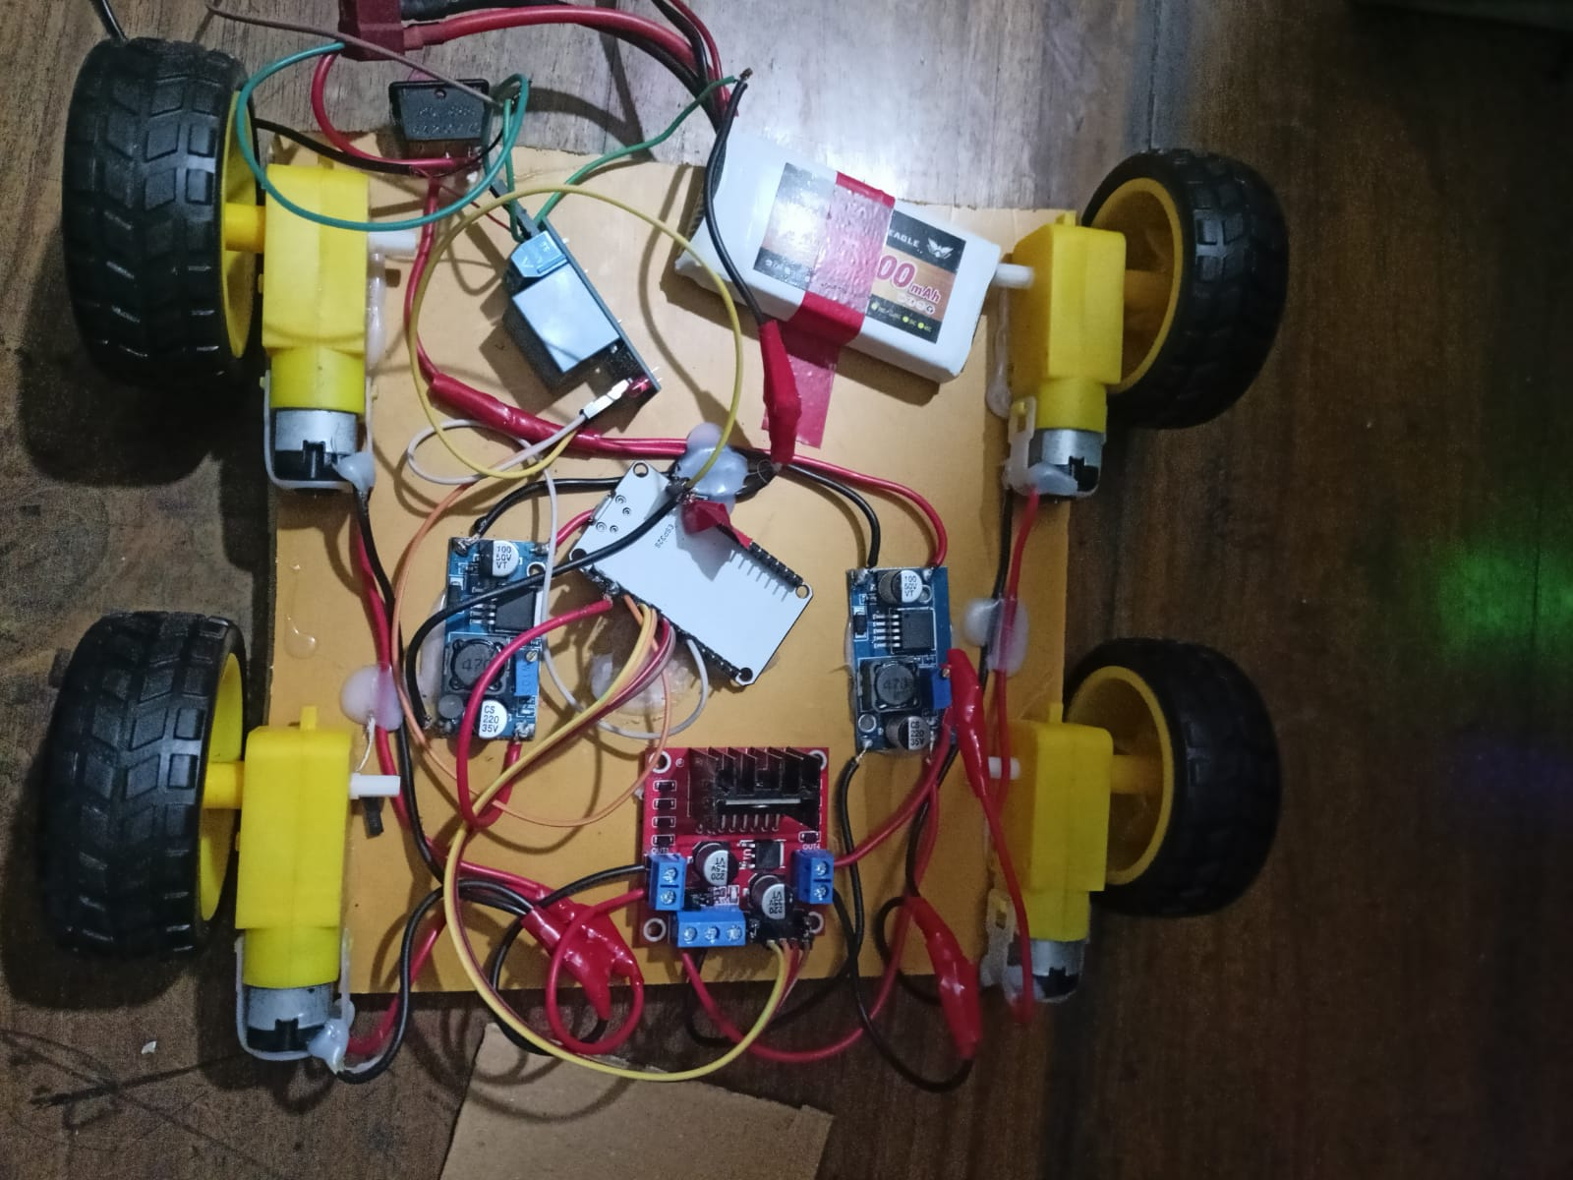
Hardware Schematic
Figure: Hardware Schematic of The Project

Slide 16
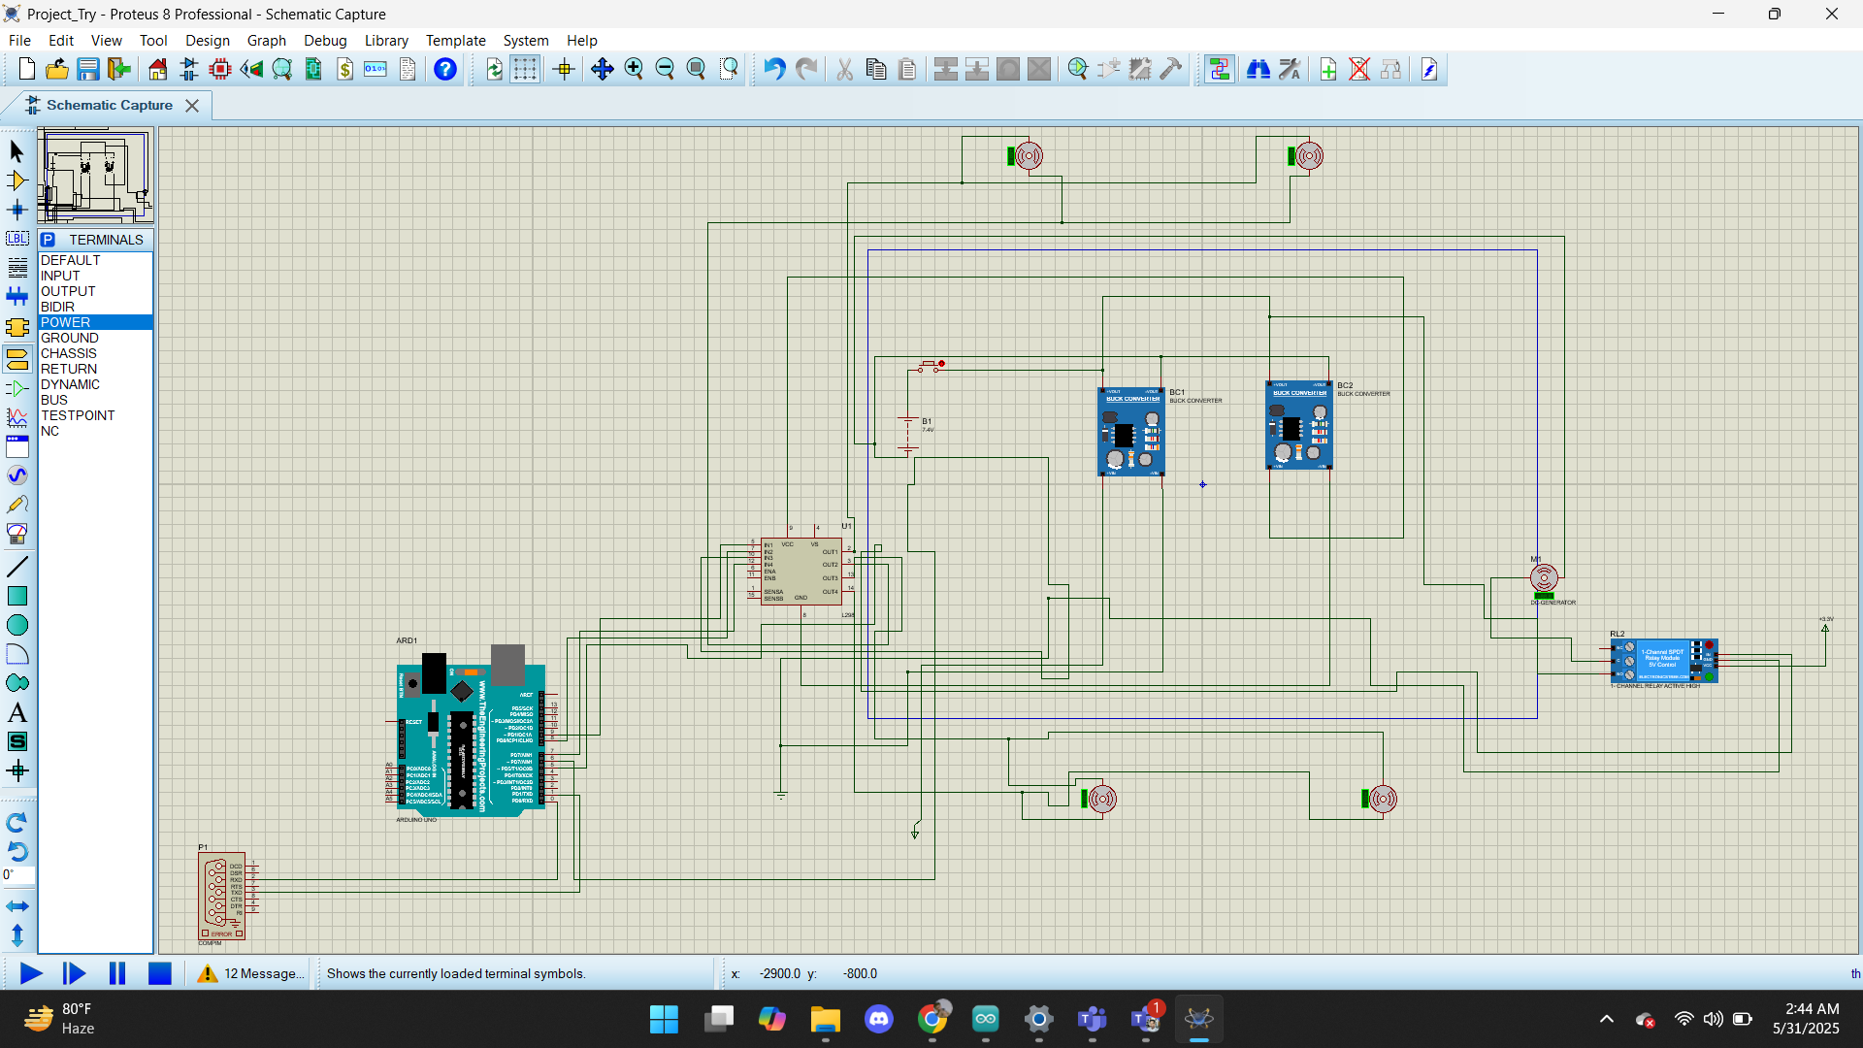
Simulation Schematic
Figure: Simulation Schematic of The Project

Slide 17
Cost Analysis
No. | Product | Quantity | Subtotal (BDT)
1 | ESP32 | 1 | 600
2 | L298N Motor Driver | 1 | 160
3 | LM2596 Buck Converter | 2 | 180
4 | Tape | 1 | 20
5 | Female Header | 1 | 30
6 | Switch | 1 | 10
7 | Yellow Motor + Wheel | 4 | 680
8 | 1 Channel 5V Relay Module | 1 | 95
9 | Female to Female Jumper Wires (20 pcs, 20cm) | 1 | 55
10 | LiPo Battery 1500mAh 7.4V 2S+ Charger | 1 | 1300+445=1745
11 | Submersible 3V Mini DC Water Pump | 1 | 120
12 | Twisted Electrical Flexible Wire - Red & Black (1m) | 2 | 90
Total Cost: 3785/- BDT

Slide 18
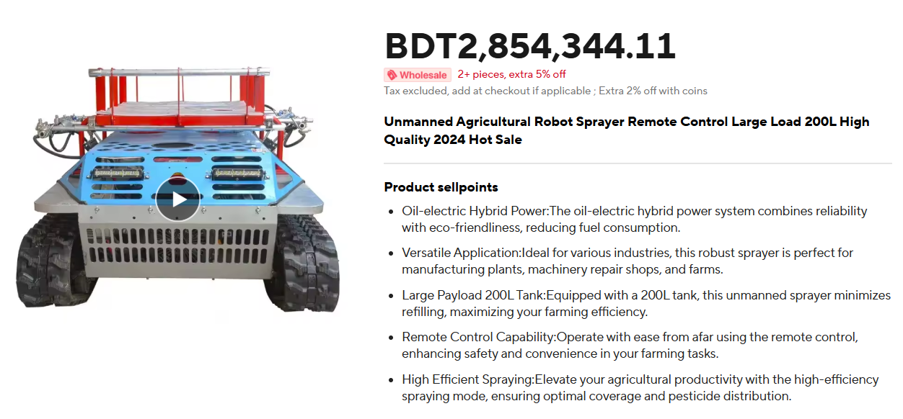
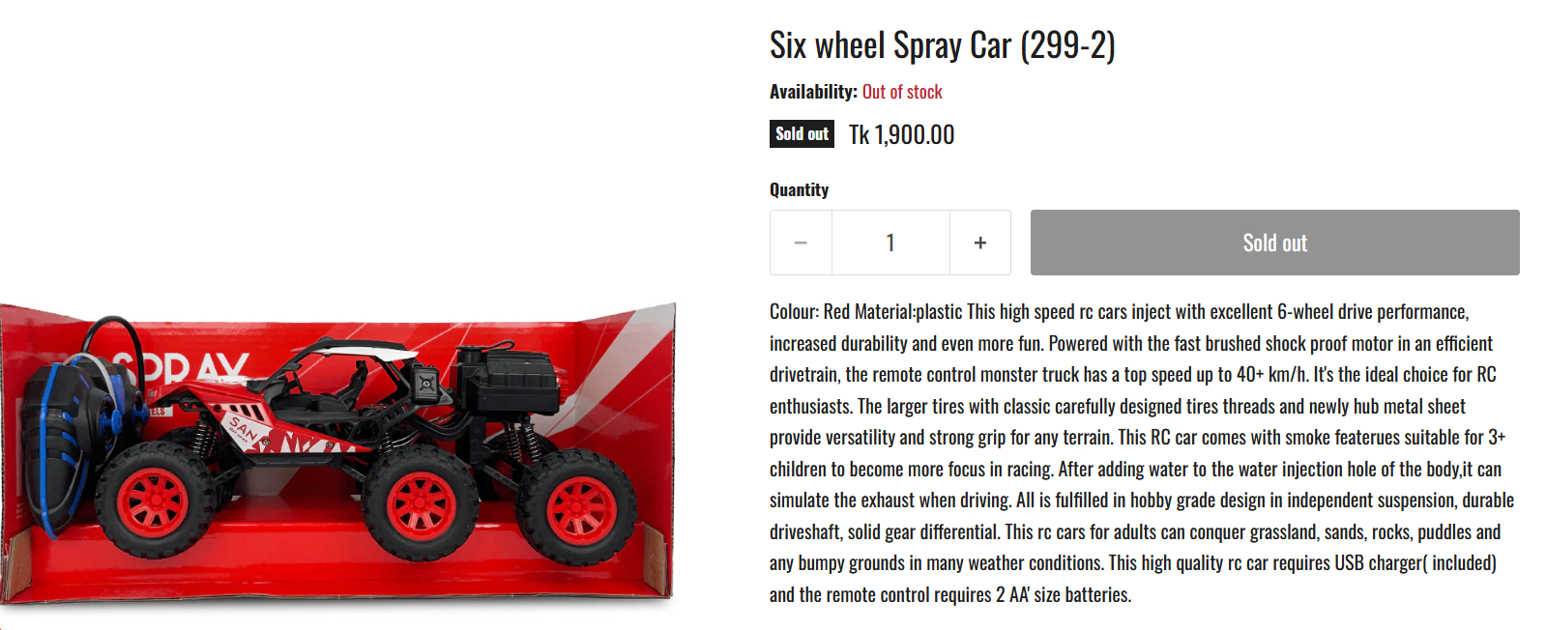
Cost Analysis
Here, we see that existing sprayer cars cost more and all of those are not suitable for Bangladeshi farmers.
So we reduced the cost while maintaining the proper requirement.

Slide 19
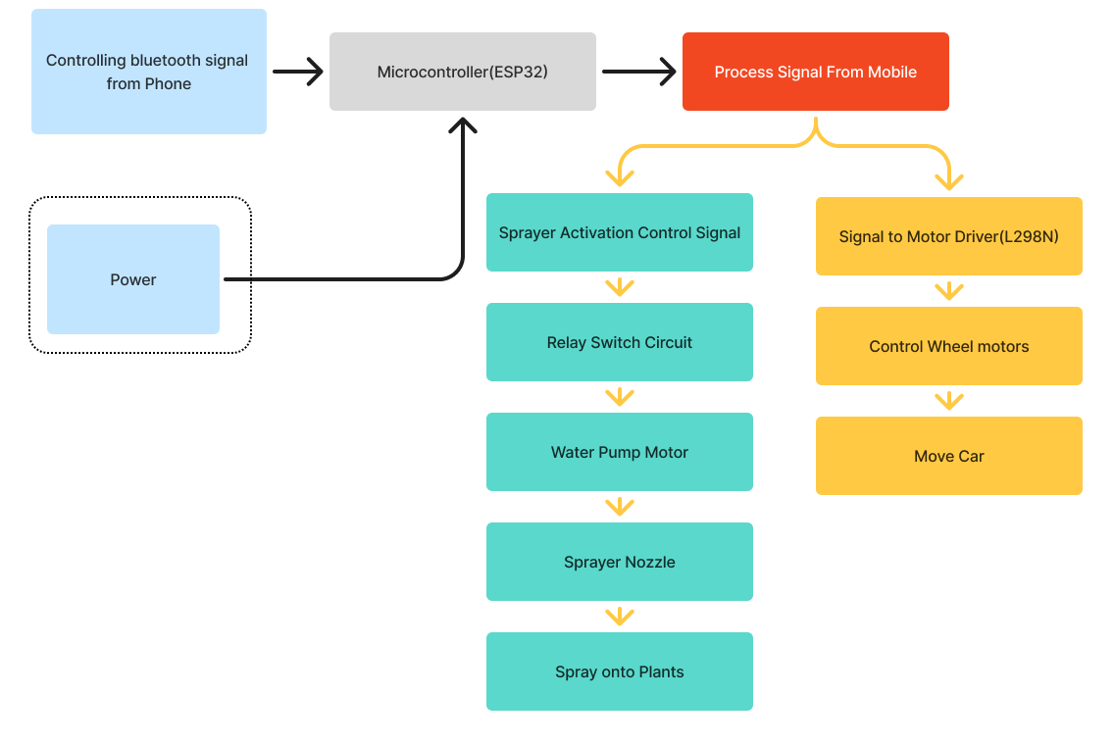
Working Method
•Battery supplies energy to the microcontroller and all connected components…

Slide 20

Working Method
•A mobile phone sends control signals to the ESP32 microcontroller using Bluetooth.
•The ESP32 processes the received signals and decides whether to activate the sprayer, or move the vehicle…

Slide 21

Working Method
•When spraying is triggered, the ESP32 sends a signal to a relay switch circuit.
•This activates the water pump motor, which pushes pesticide through the sprayer to spray onto plants...

Slide 22
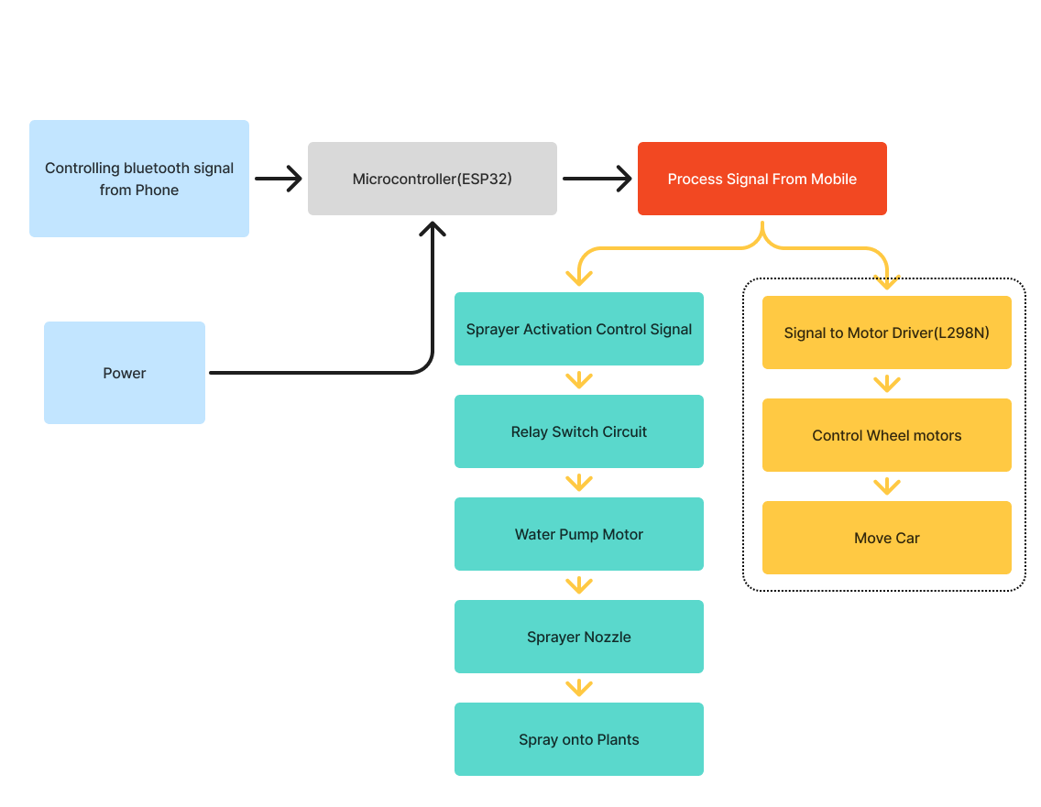
Working Method
•For navigation, the ESP32 sends movement commands to an L298N motor driver.
•Motor driver controls the wheel direction.

Slide 23
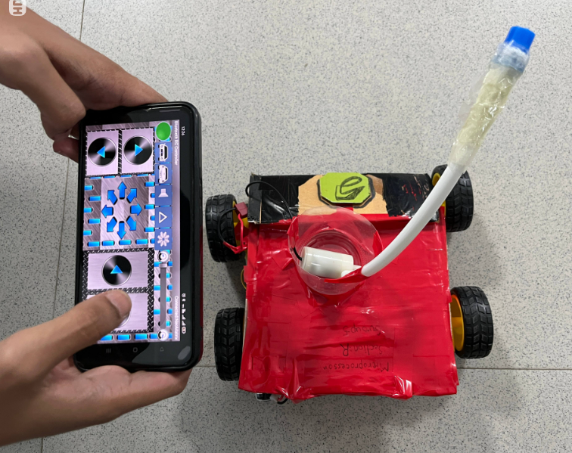
Figure: The Bluetooth Controller App with Hardware Car

Slide 24
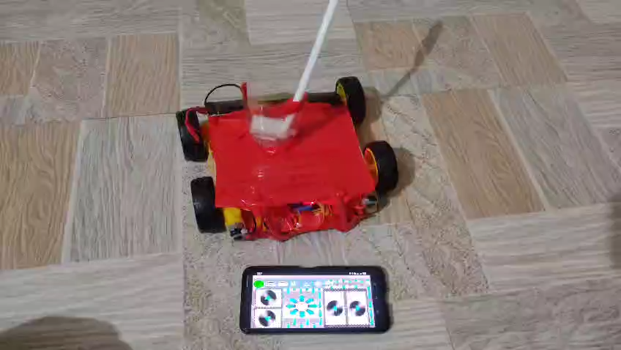
Fig . : Video showing the basic functionalities of the project

Slide 25
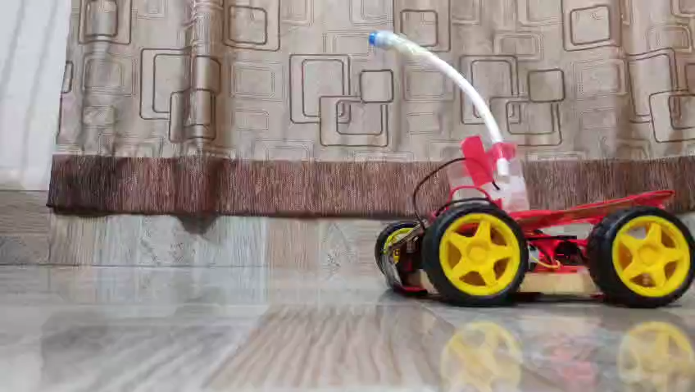
Fig . : Video showing the Spray Function of the project

Slide 26

Figure: Simulation of The Project(Before Bluetooth Input)

Slide 27

Figure: Simulation of The Project(After Bluetooth Input)

Slide 28
Hardware-Simulation Comparison
Hardware:
Worked Perfectly.
Responded according to control.
Simulation:
Worked, as every greenlight was on for COMPIM and the motors were on.
Bluetooth input makes red light on in COMPIM.
Notes:
The simulation software did not have all the required components and didn’t work perfectly.

Slide 29
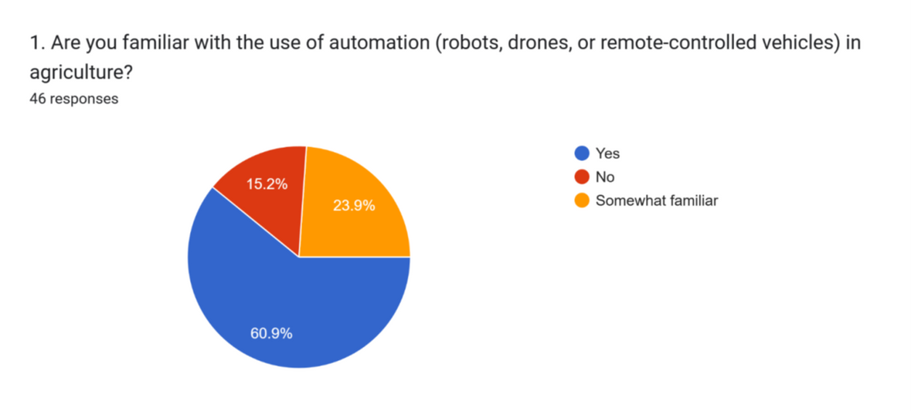
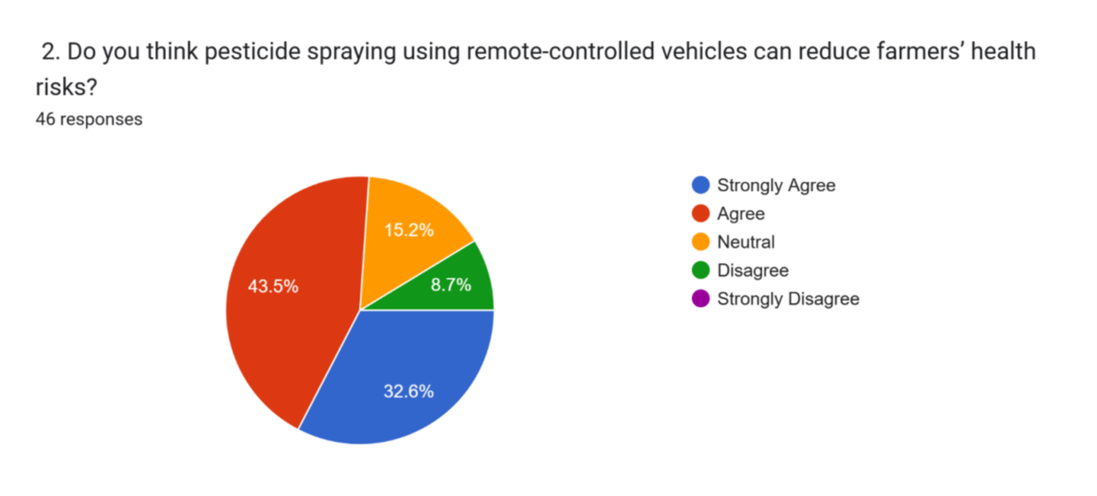
Survey
Report
Link:https://forms.gle/3RFasstXoVQzWAbF6

Slide 30
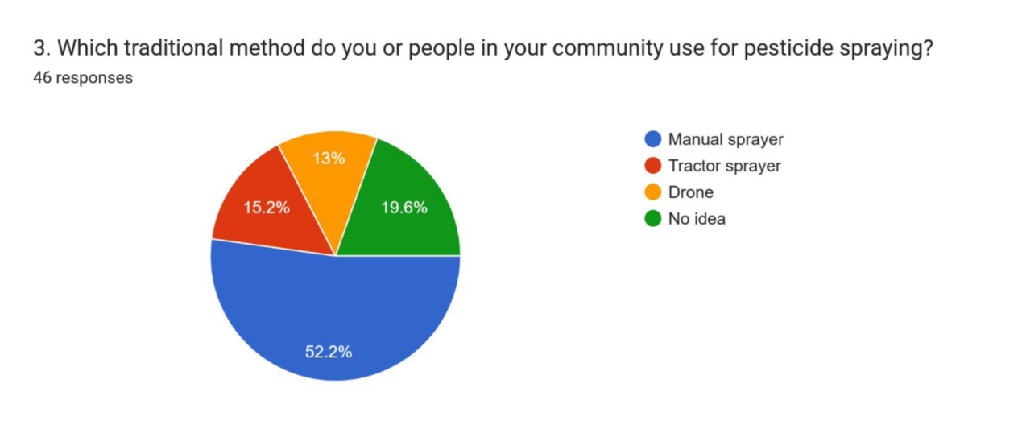
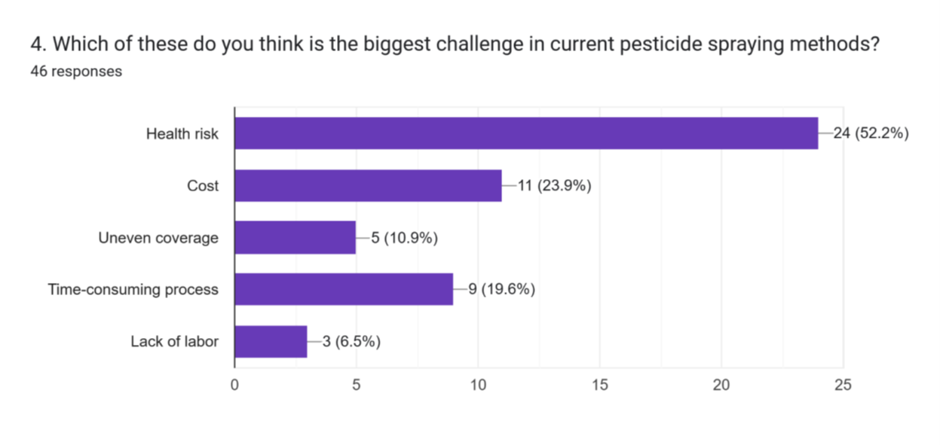
Survey
Report

Slide 31
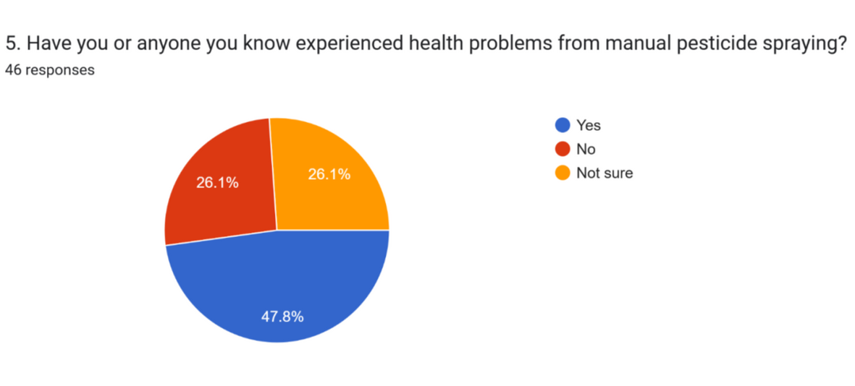
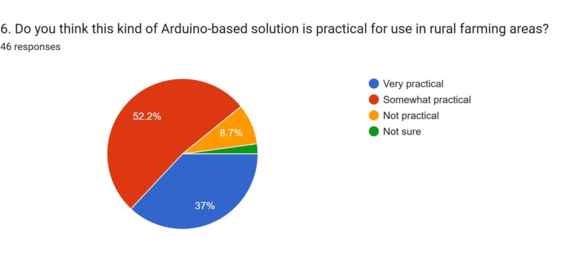
Survey
Report

Slide 32
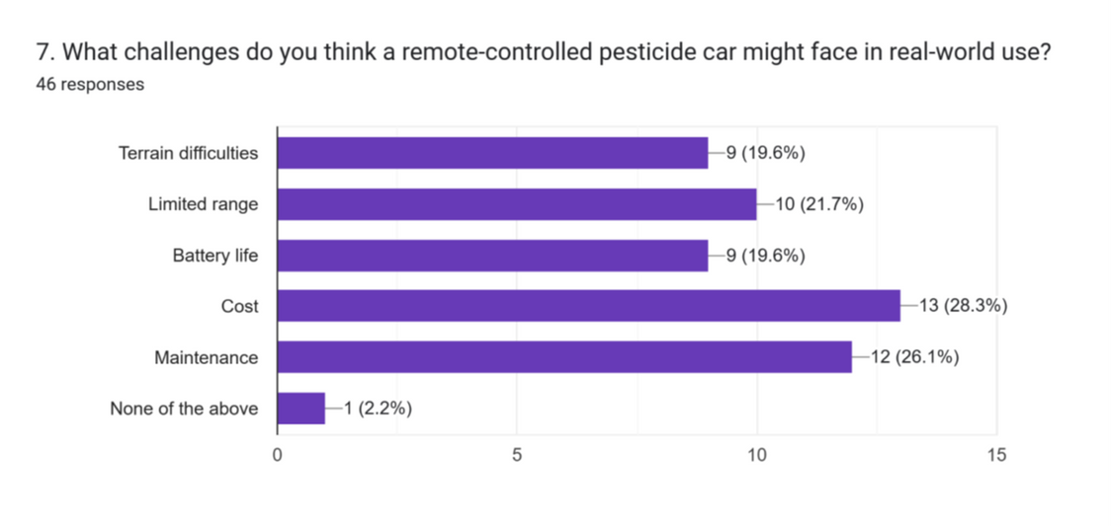
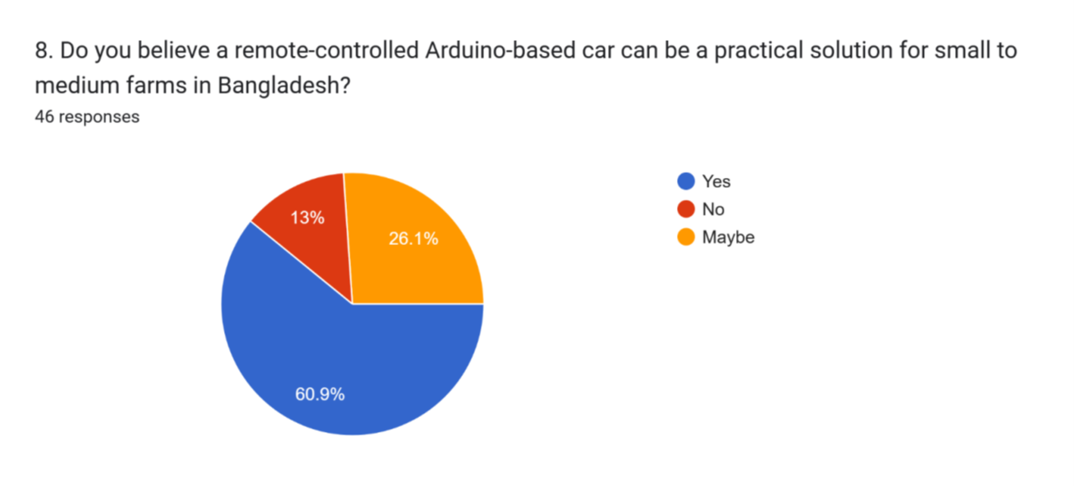
Survey
Report

Slide 33
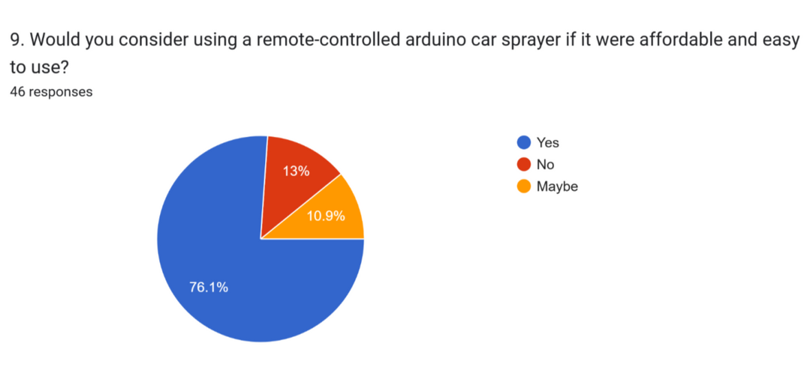
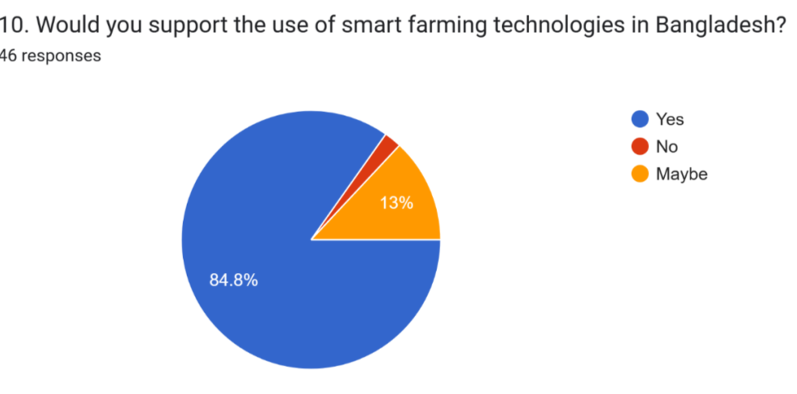
Survey
Report

Slide 34
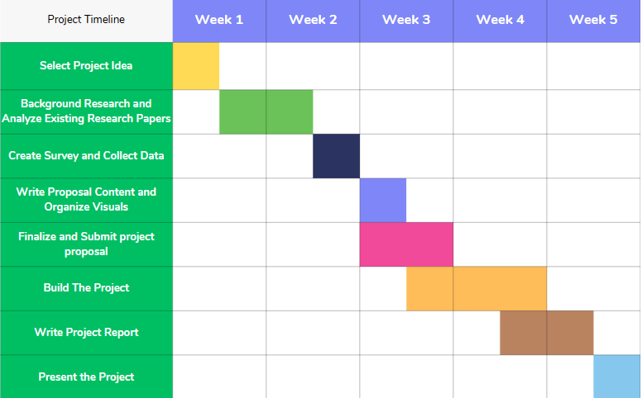
Gantt Chart
Fig. Gantt Chart of the project to show the Timeline

Slide 35
Results and Discussions
The remote-controlled pesticide sprayer car was successfully developed using the ESP32 microcontroller.
Field testing showed that the system can spray up to 30 cm consistently under standard conditions.
The car responded smoothly to remote commands, allowing operators to control movement and spraying direction from a safe distance.
Notes:
The remote-controlled pesticide sprayer car, developed with the ESP32 microcontroller, performed successfully in field tests, consistently spraying up to 30 cm under standard conditions. The spraying mechanism proved reliable whether the car was stationary or moving, providing even coverage. Low power consumption allowed extended operation without frequent battery changes. Additionally, the car responded smoothly to remote commands, enabling safe and precise control from a distance.​

Slide 36
Limitations
Reduced Speed:
Spraying requires slower movement, lowering efficiency.
Low Capacity:
Small spray tank due to short pump wire limits usage time.
Limited Coverage:
Best suited for small plots; not ideal for larger farms without upgrades.
Notes:
The system’s spraying requires slower movement, which reduces operational speed and overall efficiency. Additionally, the small spray tank, limited by the short pump wire, restricts usage time before refilling is needed. Consequently, the current design is best suited for small plots and is not ideal for larger farms without further upgrades.​

Slide 37
Future Scope
Autonomous Navigation: Implement GPS or sensor-based path planning for fully automated spraying without manual control.
Larger Tank & Pump Upgrade: Enhance the system with a bigger spray tank and more powerful pump to support larger fields.
Data Logging & Analysis: Integrate app-based tracking of spray coverage, battery usage, and performance for future optimization.
Notes:
Autonomous Navigation: Add GPS or sensor-based path planning for hands-free spraying.
Tank & Pump Upgrade: Use a larger tank and stronger pump to cover bigger areas efficiently.
Data Logging: Enable app-based tracking of spray, battery, and performance for smarter optimization.

Slide 38
Conclusion
Successfully developed an ESP32-based remote-controlled pesticide sprayer car with consistent 30 cm spray coverage.
Low power consumption and smooth remote control ensure efficient, safe, and extended field operation.
Notes:
So in conclusion, we successfully developed an ESP32-based remote-controlled pesticide sprayer car that delivers consistent 30 cm spray coverage. Its low power use and smooth control make it safe, efficient, and reliable for extended use in the field. This project sets the stage for future upgrades, including full automation and smart monitoring features.

Slide 39
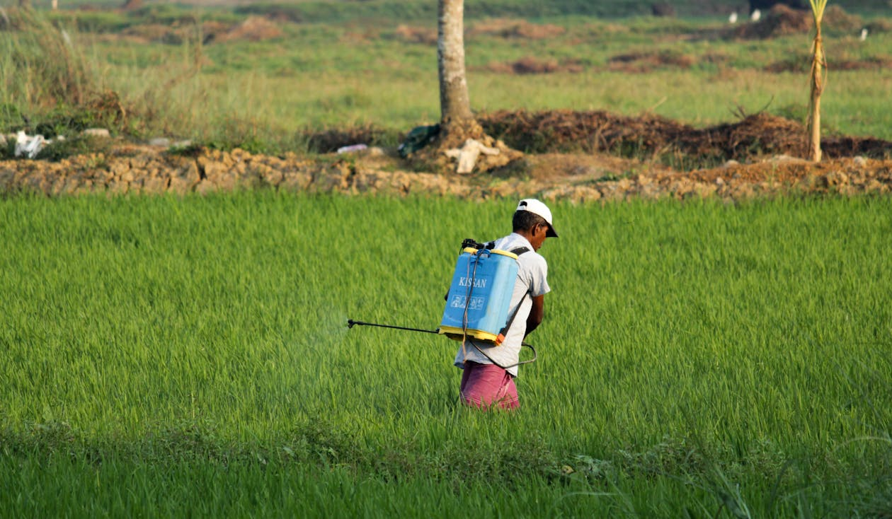
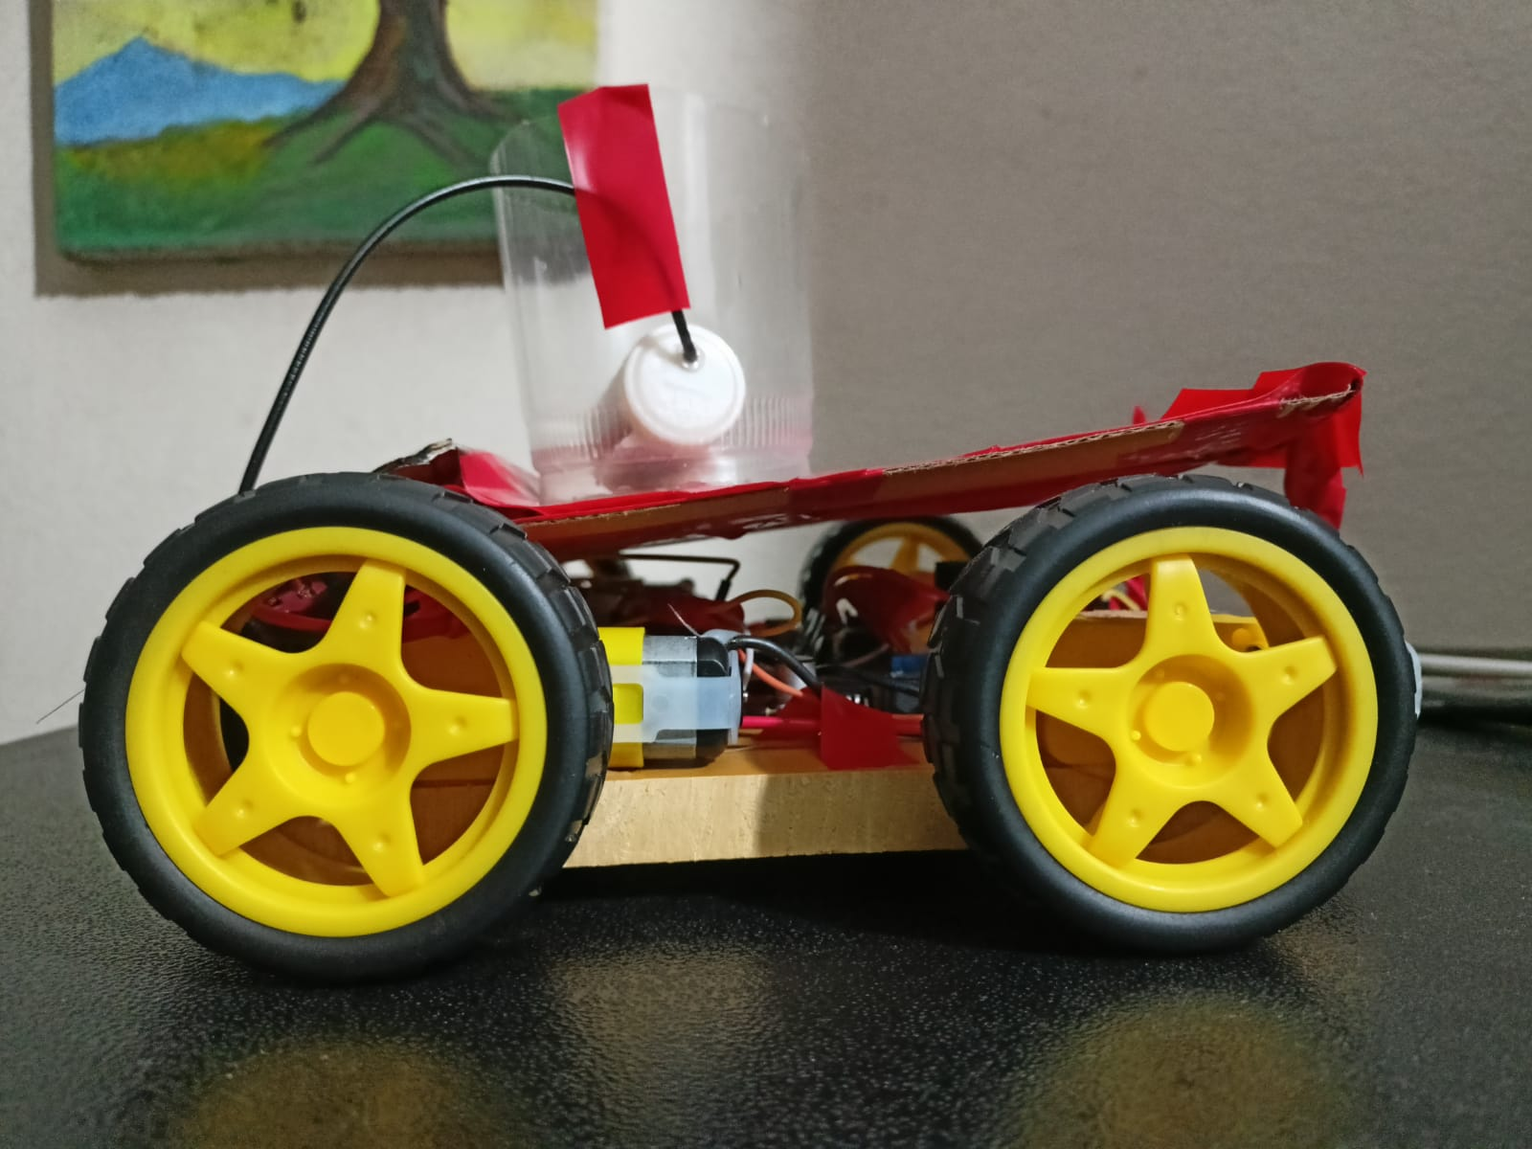
Thank You

Slide 40
References
A. N. Babu et al., “Internet of Things (IoT) based Pesticide Spraying Robot – A Revolution in Smart Farming,” Indian Journal of Science and Technology, vol. 16, no. 22, pp. 1676–1681, June 2023, https://doi.org/10.17485/IJST/v16i22.926
S. T. Ayyagari et al., “Design and fabrication of solar powered remote controlled all terrain sprayer and mower robot,” arXiv preprint, vol. arXiv:2106.05236, June 2021, https://doi.org/10.48550/arXiv.2106.05236.
3. M. A. Naik et al., “Development of a Telerobotic Target-Specific Pesticide Applicator: An Intervention for Enhanced Safety and Efficiency,” Journal of Field Robotics, vol. 42, no. 1, pp. 1–23, Feb. 2025, https://doi.org/10.1002/rob.22524
4. J. F. Kayode et al., “Development of remote-controlled solar-powered pesticide sprayer vehicle,” Discover Applied Sciences, vol. 6, article no. 101, Feb. 2024, https://doi.org/10.1002/rob.22524
5. P. K. C. et al., “Revolutionising Agriculture with Remote-Controlled Automatic Sprayer Machines,” Tuijin Jishu/Journal of Propulsion Technology, vol. 45, no. 1, pp. 4714–4724, Mar. 2024, https://doi.org/10.1001/proptech.2024.4714

